Slide 1
Finite State Machine

Slide 2
Index
Definition
A traffic light controller
State Transition Diagram
State Transition Table
State and Output Encodings
Next State Equations
Output Table
FSM Schematic
FSM timing diagram
One-hot encoding
Moore and Mealy Machines
Moore vs Mealy
Factoring State Machines
Unfactored example
Factored example
Deriving an FSM from a Schematic
Example of derivation
FSM Design procedure

Slide 3
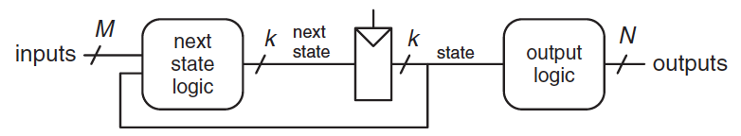
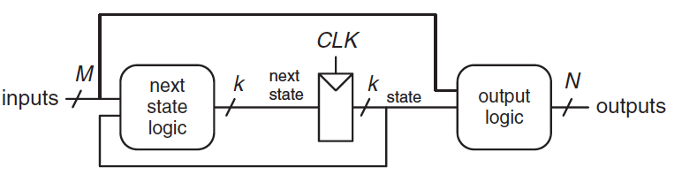
Definition
A Finite State Machine (FSM) is as synchronous sequential circuits can be drawn in the following forms:
Moore machines
the outputs depend only on the current state of the machine
Mealy machines
the outputs depend on both the current state and the current inputs
FSM provide a systematic way to design synchronous sequential circuits given a functional specification

Slide 4
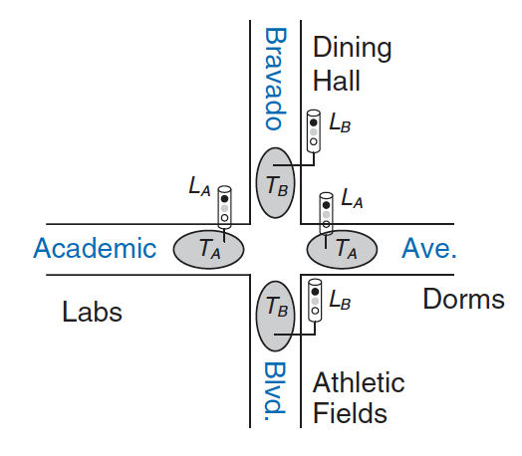
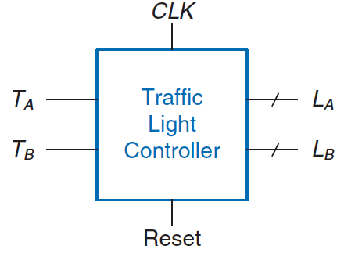
A traffic light controller
Consider the problem of a controller for a traffic light at a busy intersection
We have two traffic sensors (T_{A} and T_{B}) on the two roads
a sensor indicates TRUE if cars are present and FALSE if the street is empty
We also have two traffic lights (L_{A} and L_{B}) to control traffic
each light receives digital inputs specifying whether it should be green, yellow, or red
Hence, our FSM has two inputs (T_{A} and T_{B}) and two outputs (L_{A} and L_{B})
We have a clock with a 5-second period, on each rising edge, the lights may change based on the traffic sensors
Finally, we have a reset button to put the controller in a known initial state

Slide 5
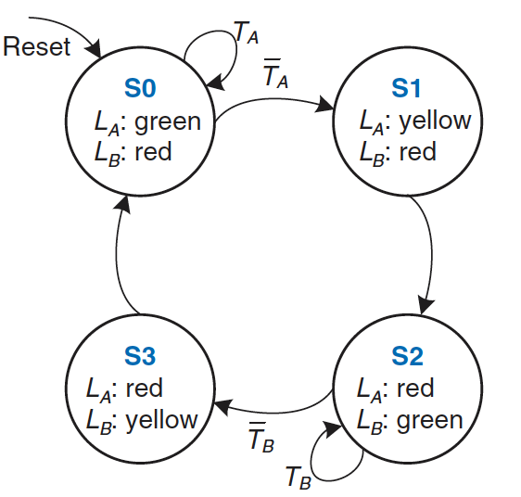
State Transition Diagram
Indicate all possible states of the system and the transitions between them
Circles represent states
Arcs represent transitions
Transitions take place on the rising edge of clock
we do not show the clock, it is always present
It simply controls when the transitions occur, whereas the diagram indicates which transitions occur
Arc pointing from outer space indicates that starting state upon reset
States with multiple arcs leaving it have arcs labelled to show what input triggers the transition
State with a single arc leaving it means that transition always occurs regardless of the inputs
The value of outputs in a particular state are indicated in the state

Slide 6
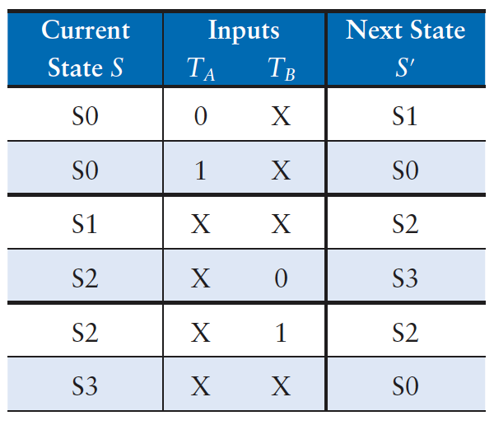
State Transition Table
Indicates, for each state and input, what the next state should be
Note that
we can uses don’t care symbols (X) whenever the next state does not depend on a particular input
reset is omitted from the table: we always go to a particular state on reset, independent of the inputs

Slide 7
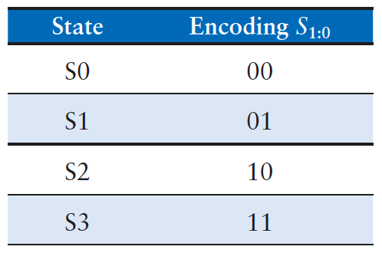
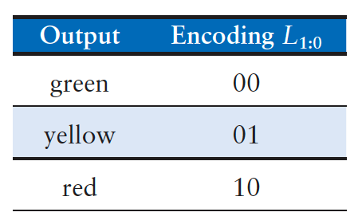
State and Output Encodings
States {S0, S1, S2, S3} and outputs {red, yellow, green} must be assigned binary encodings
Encodings are selected arbitrarily
a different choice can result in a different circuit
how to determine the encoding that produces the circuit with the fewest logic gates or the shortest propagation delay?
There is no simple way to find the best encoding except to try all possibilities
Computer-aided design (CAD) tools are also good at searching the set of possible encodings and selecting a reasonable one

Slide 8
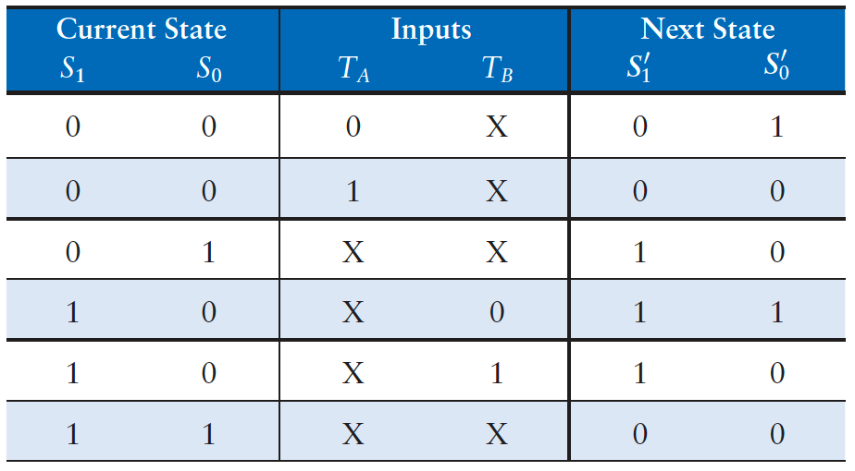
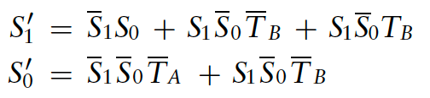
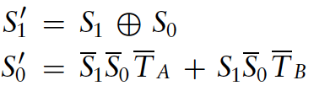
Next State Equations
We can updates the state transition table to use binary encodings
Now it is a truth table specifying the next state logic
it defines the next state as a function of the current state and the inputs
it is straightforward to read off the Boolean equations for the next state
the equation can be simplified, using Karnaugh maps or by inspection

Slide 9
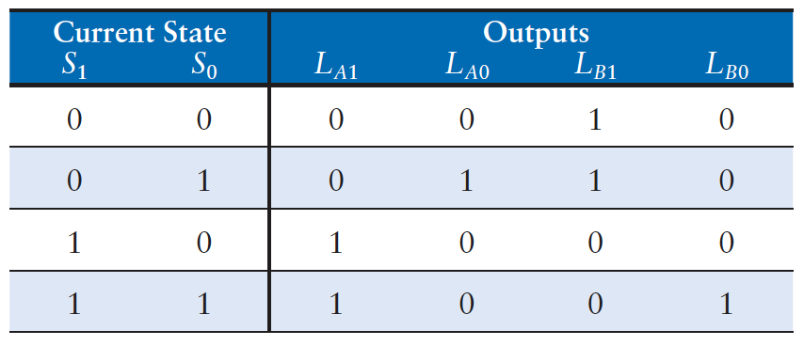
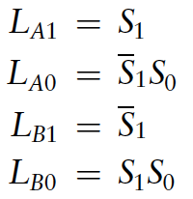
Output Table
Indicates, for each state, what the output should be in that state
Again, we can read off and simplify the Boolean equations for the outputs

Slide 10
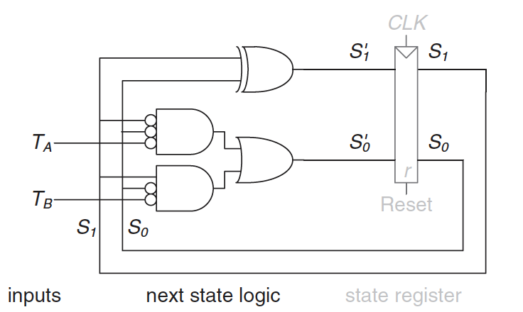
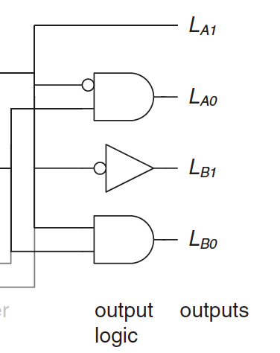
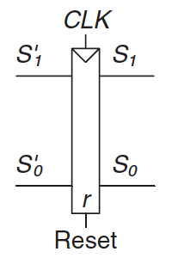

FSM Schematic
Finally, we can sketch the FSM (Moore form)

Slide 11
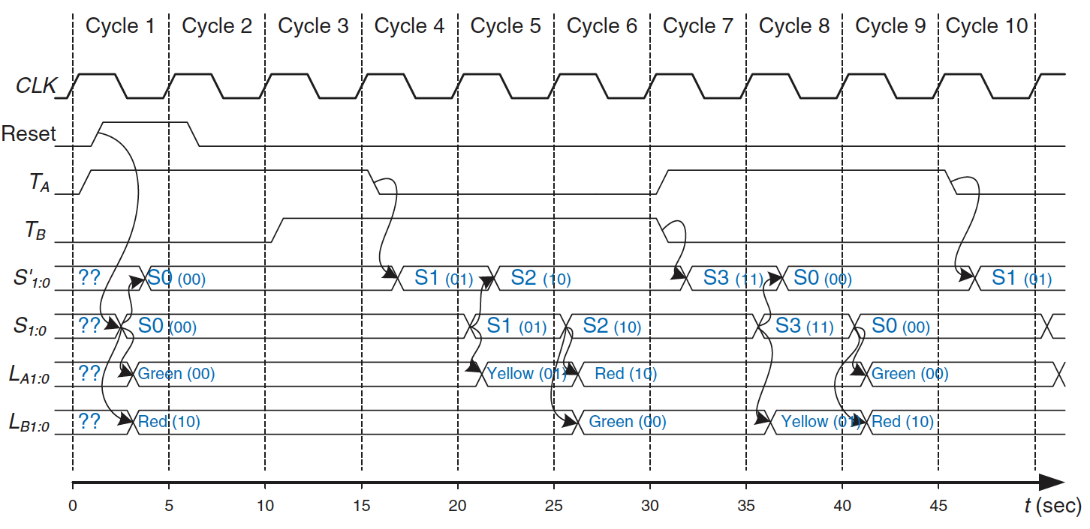
FSM timing diagram

Slide 12
One-hot encoding
In the example, we used a binary encodings
a system with K states needs log₂K bits of state
Another possibility is to use one-hot encoding
a separate bit of state used for each state
it is called “one-hot” because only one bit is “hot” (TRUE) at any time
each bit of state is stored in a flip-flop, so it requires more flip-flops than binary encoding
however, the next state and output logic are often simpler, so fewer gates are required
A related way is the one-cold encoding
K states are represented with K bits, exactly one of which is FALSE
The best encoding choice depends on the specific FSM

Slide 13
Moore and Mealy Machines
Moore machines
the output depends only on the state
outputs are labelled in the circles
Mealy machines
the outputs can depend also on inputs
the outputs are labelled on the arcs
We can compare Moore and Mealy state machine designs with an example
A digital system get in input a sequence of 1 and 0. On each clock cycle, the system gets the next bit. The system should recognize when the last two bits are 0 1
the input A is the current bit
the output Y is TRUE when the last two bits are 0 1

Slide 14

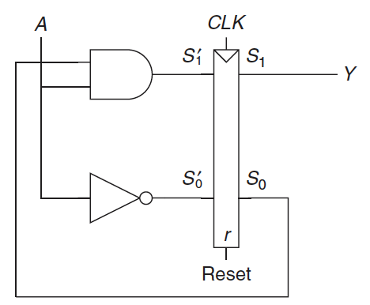
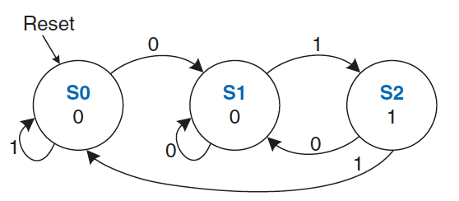
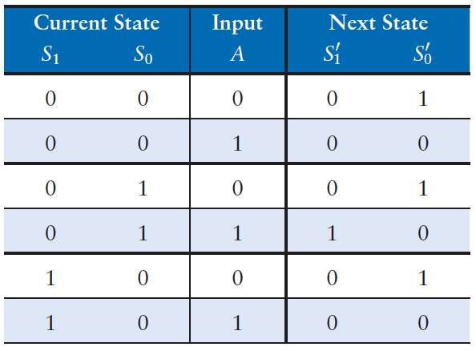
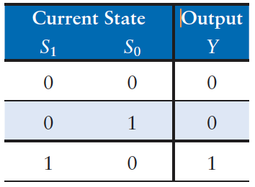

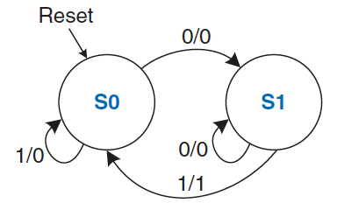
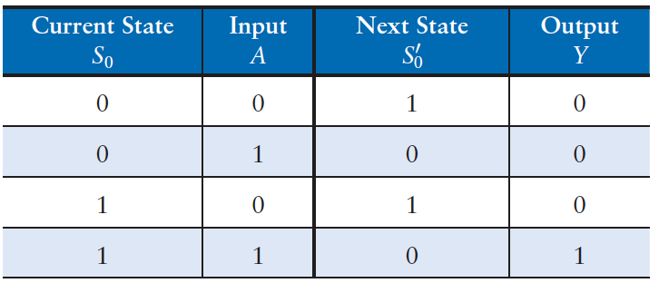
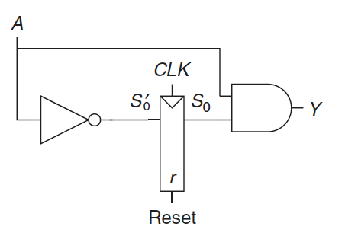


Moore vs Mealy Machines (1)
The Moore machine requires three states:
The Mealy machine requires only two states
each arc is labelled as A/Y: A is the value of the input that causes that transition, and Y is the corresponding output

Slide 15
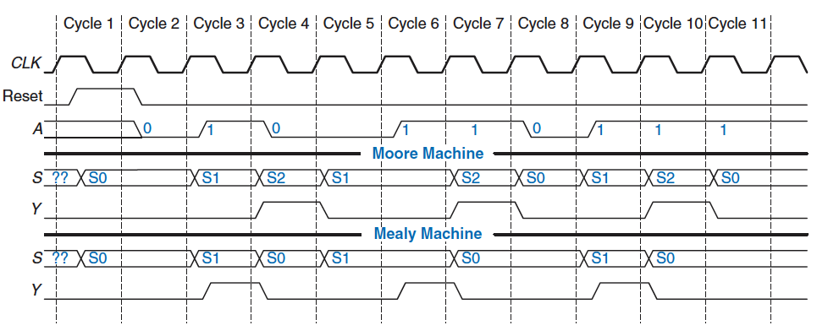
Moore vs Mealy Machines (2)
The timing diagrams:
The Mealy machine rises a cycle sooner because it responds to the input rather than waiting for the state change
When choosing your FSM design style, consider when you want your outputs to respond.

Slide 16
Factoring State Machines
Designing complex FSMs is often easier if they can be broken down into multiple interacting simpler state machines
the output of some machines is the input of others
application of hierarchy and modularity
As an example, we can modify the traffic light controller to have a special mode, which keeps L_{B} green for a specific period
the controller receives two more inputs: P and R
asserting P for at least one cycle enters the special mode
asserting R for at least one cycle leaves the special mode
when in special mode, the controller proceeds through its usual sequence until L_{B} turns green, then remains in that state until special mode ends

Slide 17
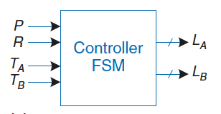
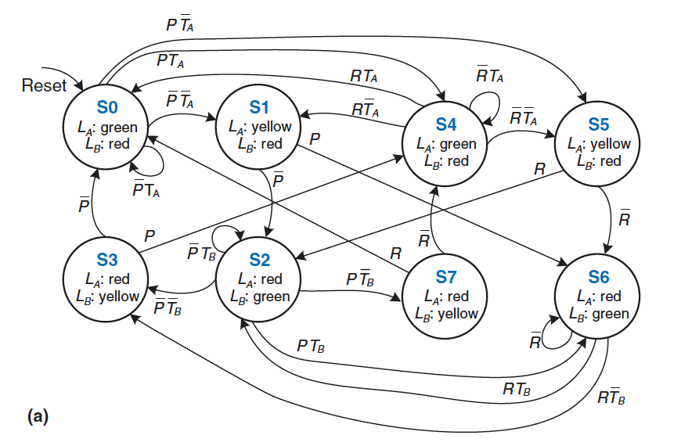
Unfactored example
The FSM is messy and tedious to design.

Slide 18
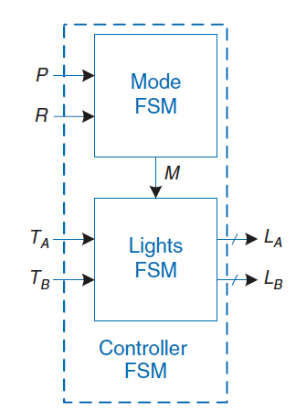
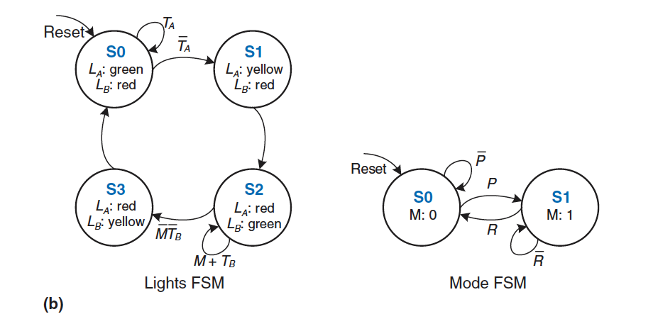
Factored example
A factored design use two FSM
Mode FSM has two states to track whether the lights are in normal or special mode
Lights FSM is modified to remain in S2 while M is TRUE

Slide 19
Deriving an FSM from a Schematic
Deriving the state transition diagram from a schematic follows nearly the reverse process of FSM design
when taking on an incompletely documented project
reverse engineering somebody else’s system
Algorithm:
examine circuit, stating inputs, outputs, and state bits
write next state and output equations
create next state and output tables
reduce the next state table to eliminate unreachable states
assign each valid state bit combination a name
rewrite next state and output tables with state names
draw state transition diagram
state in words what the FSM does

Slide 20
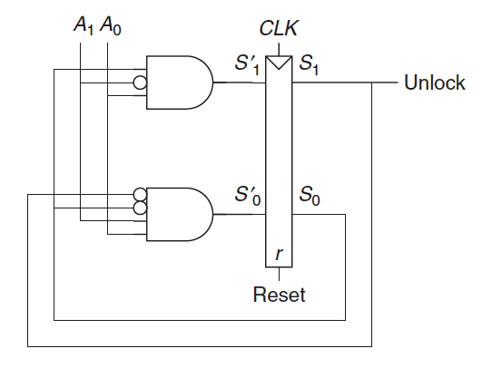
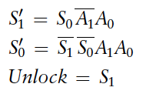
Example of derivation (1)
Derive the state transition diagram of the following circuit of a keypad lock
The input is A1:0 and the output is Unlock
This is a Moore machine because the output depends only on the state bits
From the circuit, we can writes down the next state and output equations directly:

Slide 21
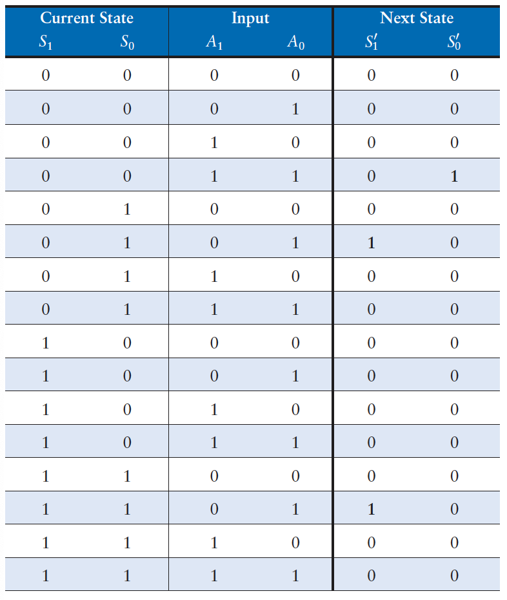
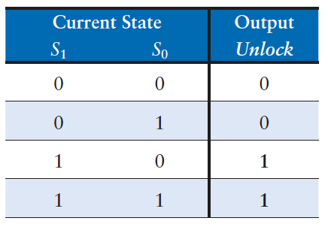
Example of derivation (2)
We can writes down the next state and output tables from the equations:
placing 1 in the tables as indicated by the equation
placing 0 everywhere else

Slide 22
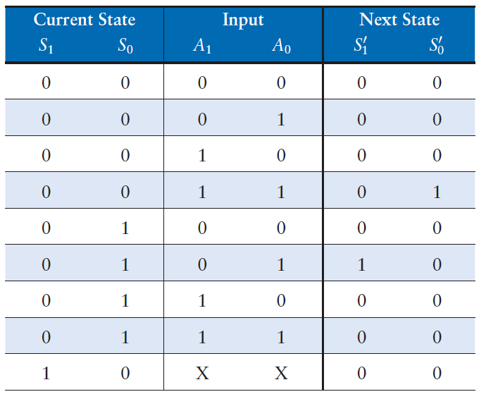
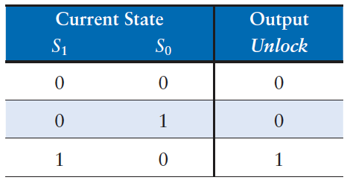
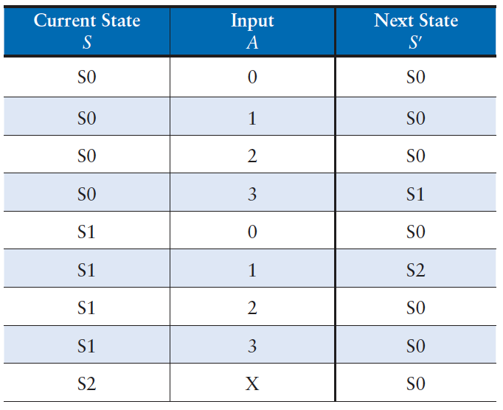
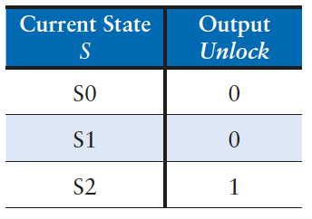
Example of derivation (3)
We can reduces the table by removing unused states and combining rows using don’t cares and assigns names to each state bit combination

Slide 23
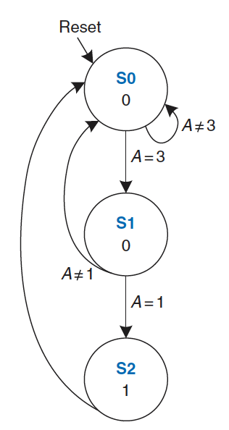
Example of derivation (4)
Finally, we write down the state transition diagram using tables
by inspection, we can see that the FSM unlocks the door only after detecting an input value of three followed by an input value of one
the door is then locked again.

Slide 24
FSM Design Procedure
Identify the inputs and outputs
Sketch a state transition diagram
For a Moore machine:
write a state transition table
write an output table
For a Mealy machine:
write a combined state transition and output table
Select state encodings—your selection affects the hardware design
Write Boolean equations for the next state and output logic.
Sketch the circuit schematic

Slide 25
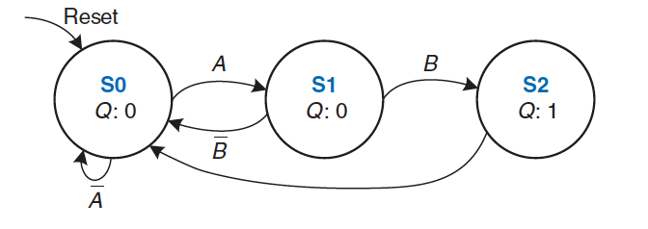
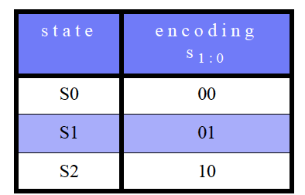
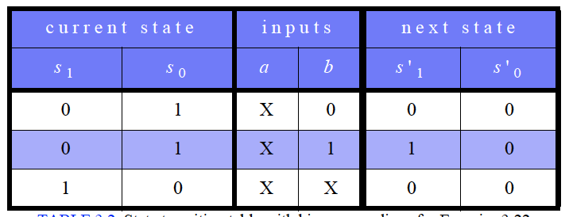
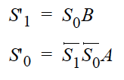

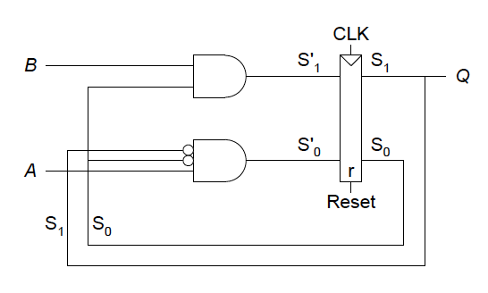
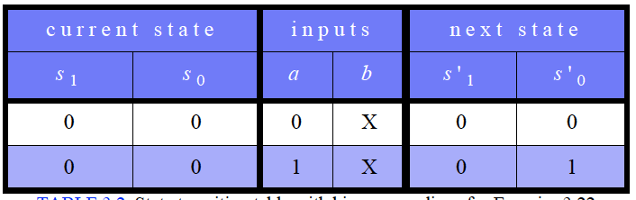
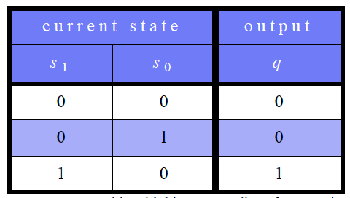
Exercises (1)
ExXX.1: Describe in words what the FSN in figure does. Using binary state encodings, complete a state transition table and output table. Write Boolean equations for the next state and output and sketch a schematic of the FSM.
Solution: this finite state machine asserts the output Q for one clock cycle if A is TRUE followed by B being TRUE.
This finite state machine asserts the output Q for one clock cycle if A is
TRUE followed by B being TRUE.

Slide 26
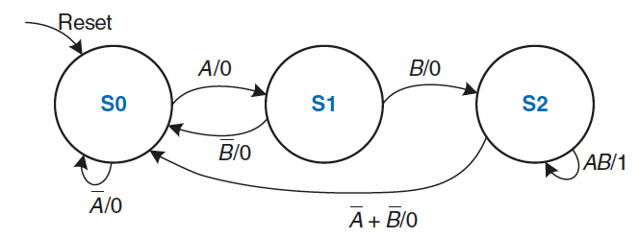
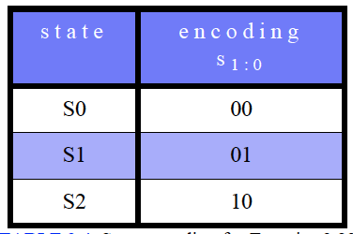
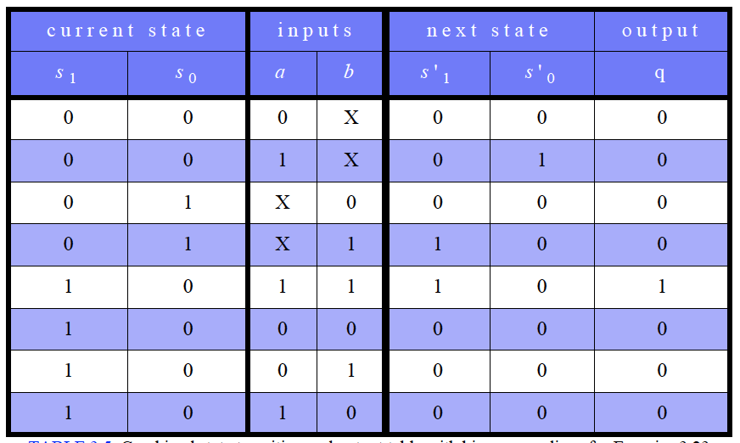
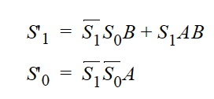

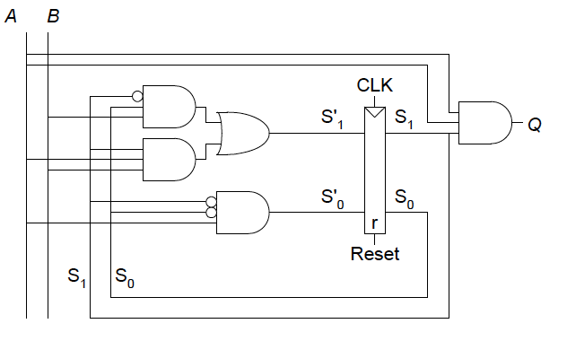
Exercises (2)
ExXX.2: Describe in words what the FSM in figure does. Using binary state encodings, complete a state transition table and output table for the FSM. Write Boolean equations for the next state and output and sketch a schematic of the FSM.
Solution: this finite state machine asserts the output Q when A AND B is TRUE.

Slide 27

Exercises (3)
ExXX.3: Design an FSM controller for a soda machine dispenser. Sodas cost 25 cents. The machine accepts nickels, dimes, and quarters. When enough coins have been inserted, it dispenses the soda and returns any necessary change.
Solution:

Slide 28





Exercises (4)

Slide 29



Exercises (5)

